Slide 1
Data Science Interview Project

Slide 2
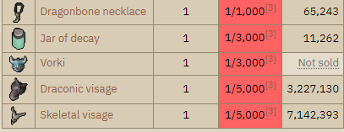
1. Define The Problem
I want to receive a rare reward from the Drop Table!
The rarest items
The Drop Table contains:
90 distinct items
Vorkath. Old School RuneScape Wiki. (n.d.). https://oldschool.runescape.wiki/w/Vorkath

Slide 3
1. Define The Problem (Cont.)
How many more iterations will it take to receive a rare reward? (Geometric Distribution)
Does the number of iterations affect the average value of the rewards?
Can I use Simple Linear Regression to make predictions?

Slide 4
2. Data Collection
Character log file
Query OSRS-db
Python API
Extract from local client
Drop Table
Query OSRS-db
Python API
Web Scrape (Beautiful Soup)

Slide 5
.log File
Data is stored using JSON (JavaScript Object Notation)
Example
{"name":"Vorkath","level":732,"killCount":7,"type":"NPC","drops":[{"name":"Superior dragon bones","id":22124,"quantity":1,"price":10141},{"name":"Superior dragon bones","id":22124,"quantity":1,"price":10141},{"name":"Blue dragonhide","id":1751,"quantity":1,"price":1435},{"name":"Blue dragonhide","id":1751,"quantity":1,"price":1435},{"name":"Rune longsword","id":1303,"quantity":1,"price":18395},{"name":"Rune longsword","id":1303,"quantity":1,"price":18395},{"name":"Red dragonhide","id":1750,"quantity":23,"price":1984}],"date":"Apr 22, 2024, 9:50:15 PM"}

Slide 6
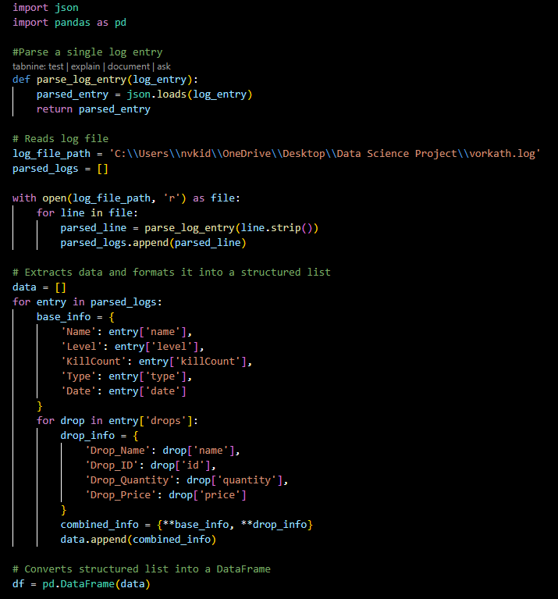
3. Clean and Parse (Script)
Handling Missing Value
Detect Missing Values
Imputate
Forward/Backward Fill
Remove
2. Data Consistency
Standardize Data Formats
Correct Data Entry Errors
Remove
3. Data Transformation
Encoding Categorical Variables
4. Feature Engineering
Create New Features

Slide 7
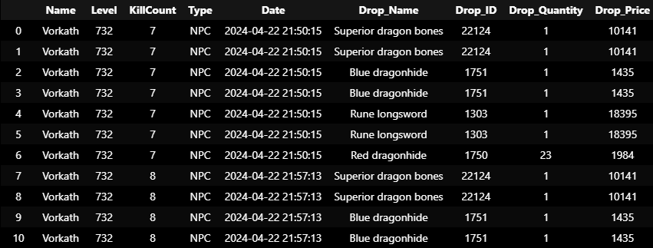
Clean and Parse (Output)
Output
This is the complete output of the log file after cleaning and parsed. This is more manageable with high readability.

Slide 8
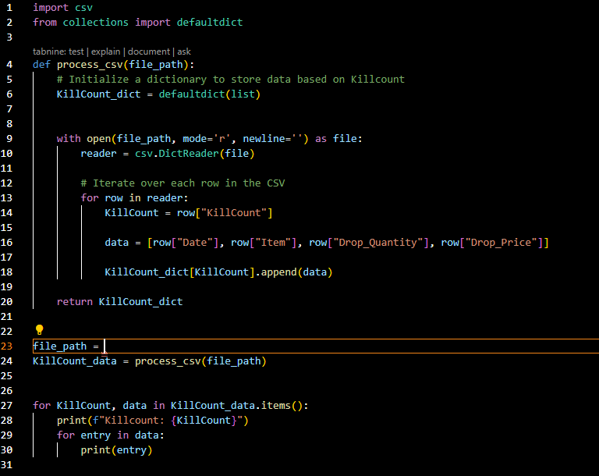
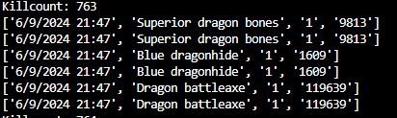
Data Cleaning of drops
Final Output

Slide 9
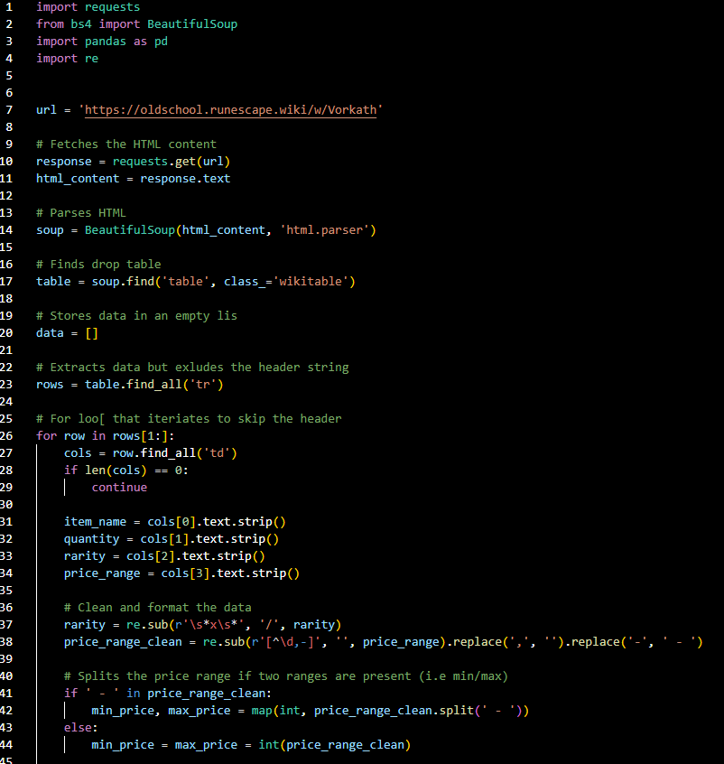
Drop Table
All the data from the Drop Table was web scraped using Pythons Beautiful Soup Library and then made into a data frame.
Why this web scraping?
Access to large volumes of data
Reduction is human error
Automated
Easily formatted

Slide 10
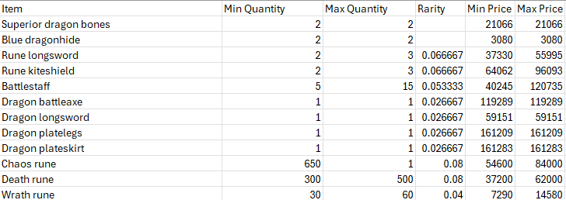
Data Frame Output

Slide 11
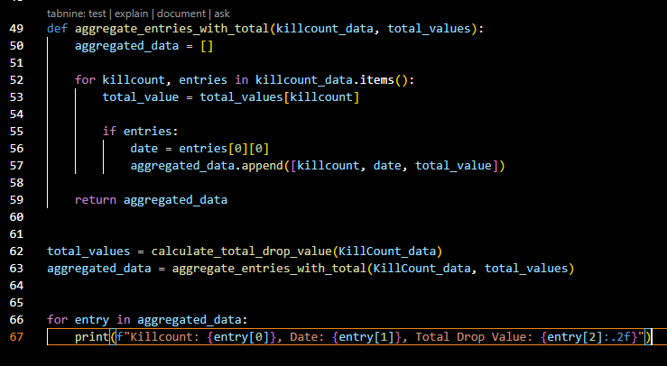
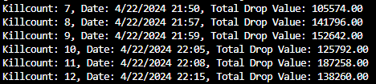
4. Exploratory Data Analysis (EDA)
Wrote a script for an aggregate function. This helps understand patterns, identify relationship, and gather insights through statistical methods

Slide 12
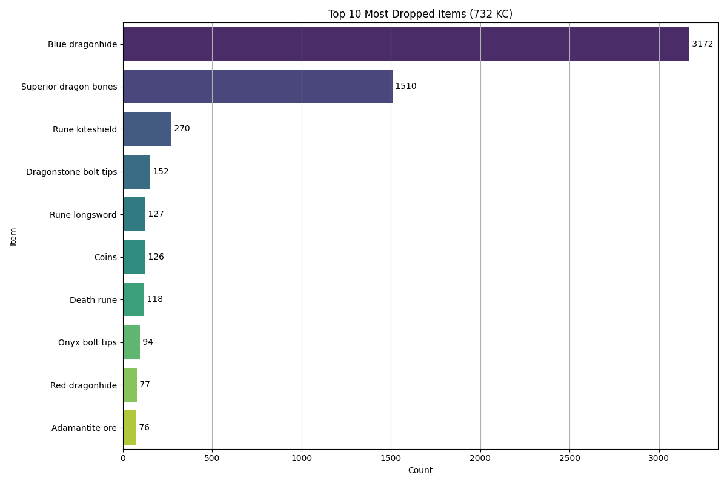
Exploratory Visualization

Slide 13
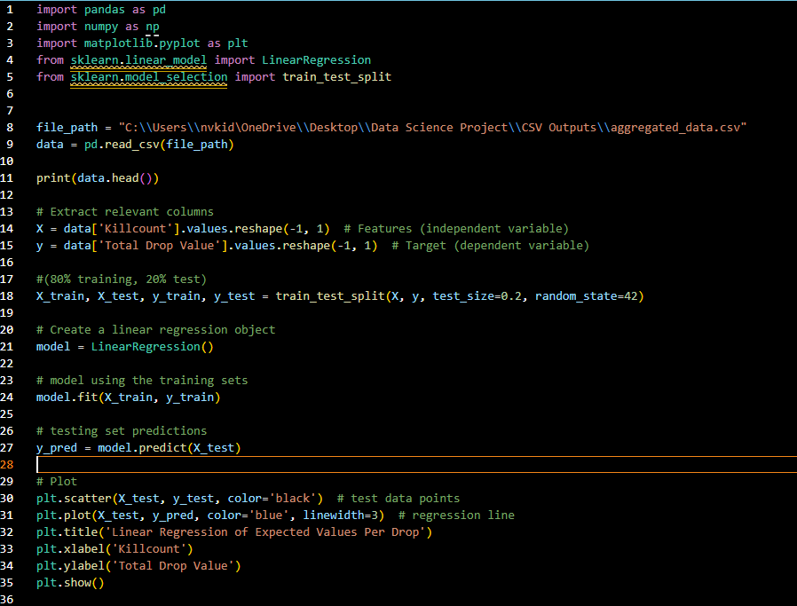
Linear Regression (Script)
Can I use Simple Linear Regression to make predictions?
Does the number of iterations affect the average value of the rewards?

Slide 14
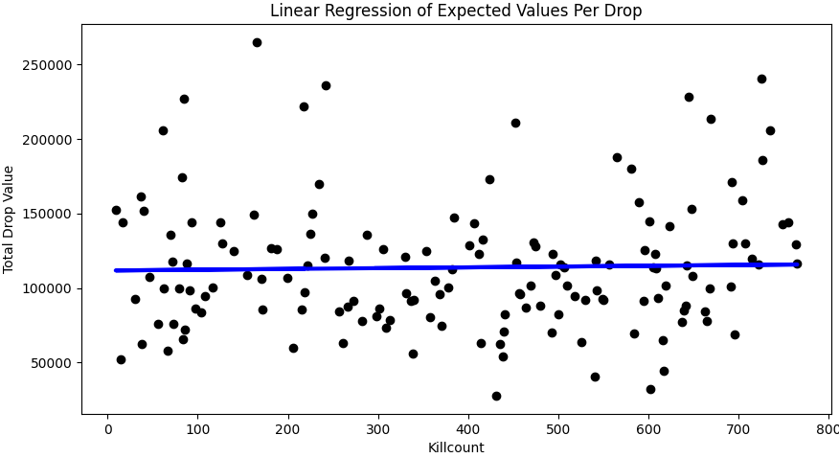
Linear Regression (Scatterplot)
Is it Linear?
Is it Independent?
Can I use Simple Linear Regression to make predictions? Yes!
Does the number of iterations affect the average value of the rewards? No!

Slide 15
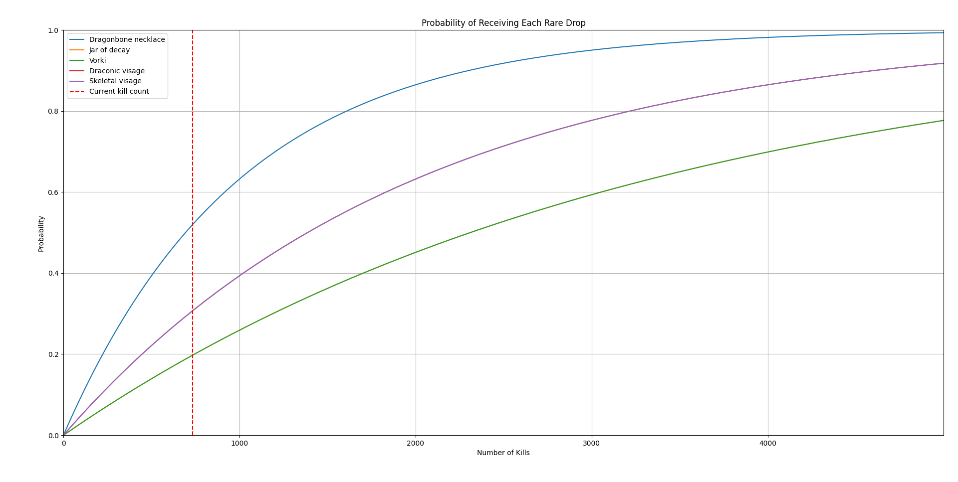
How many more iterations will it take to receive a rare reward?
Each iteration has exponential growth until it evens out near 3000
A rare drop never has an occurrence of 100% and thus not guaranteed.
However: Probability of a success increases with the number of trails. Reflecting Geometric Distributions.
P (X = k) = (1−p) k × p ; k = 0, 1, 2, 3, …….

